Slide 1
Scoring Proposal Strengths Through The Eyes Of The Evaluator
Bruce Morton
APMP Fellow & President, 2 Oceans
June 4, 2024

Slide 2
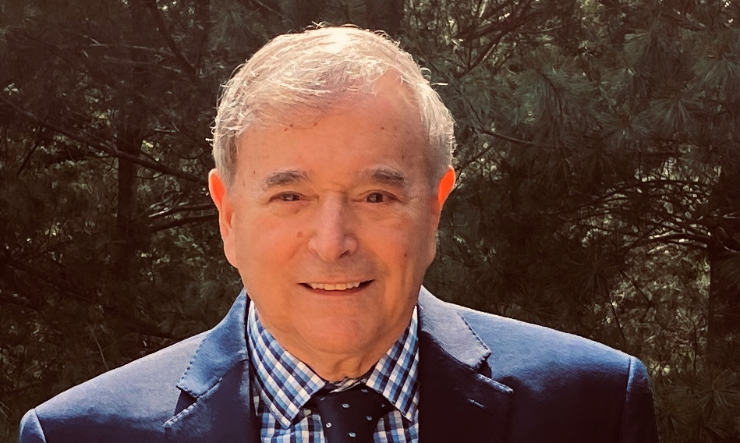
Presenter
Bruce Morton
APMP Fellow & President, 2 Oceans
bmorton10@aol.com
703-405-3103
Prior Capture Management Director positions at
Lockheed Martin, Raytheon, CACI, & SAIC
Spacecraft System Design Engineer at GE Aerospace
Concurrently taught Graduate Courses in Cybersecurity at George Washington University in DC
Presenter and/or Panelist at APMP BPC Conferences since 2007
Bruce Morton – 4 June 2024
2

Slide 3
Most Proposals Have A Major Issue
What you submit (per your Win Strategy)
Win Themes
Discriminators
Text and Graphics
Price
What is evaluated & scored by an Evaluator
(per the Evaluation Criteria in the RFP)
Strengths & Significant Strengths
Weaknesses & Significant Weaknesses
Deficiencies
Risks
Price
Bruce Morton – 4 June 2024
3

Slide 4
Proposal Evaluation Criteria
A US Government Request for Proposal (RFP) typically contains clearly stated Evaluation Criteria
e.g. “Section M - Evaluation Criteria” or equivalent
The Evaluation Criteria states and describes the evaluation factors and subfactors & their relative weights
Typically does not directly include hot buttons
Bruce Morton – 4 June 2024
4

Slide 5
Proposal Evaluators
Proposal Evaluators are individuals who may be borrowed from within the organization that is requesting the work or from other different organizations
Proposal Evaluators are assigned specific proposal sections or subsections to evaluate, and typically evaluate the same sections for each competitor
When Proposal Evaluators have completed their assigned set of evaluations they will then return to their day jobs at their parent organizations
Proposal Evaluators may or may not be familiar with the opportunity being bid and may not even be familiar with your company
Bruce Morton – 4 June 2024
5

Slide 6
What do Proposal Evaluators do?
Evaluators have a scoresheet to complete based on the Evaluation Criteria in the RFP (i.e. evaluation factors and subfactors & their relative weights)
In the United States, per the Federal Acquisition Regulations (FAR), Evaluators must score based on observed Strengths, Weaknesses, Deficiencies, & Risks
Any proposal content that is not described in the evaluation factors and subfactors is not scored
For each competitor, Evaluators read or skim their assigned proposal section or subsection to discern the info they need to complete the scoresheet
Bruce Morton – 4 June 2024
6

Slide 7
How to Assist The Proposal Evaluator
Don’t assume that the Evaluator can easily convert all your win themes into strengths or significant strengths
You need to assist the Evaluator with this process, and plan in advance how to do this
You should provide proposal content that the Evaluator can easily transition to Strengths
You need to clearly communicate strengths in your proposal
Your proposal content should be designed to be easily converted into strengths by the Evaluator
Bruce Morton – 4 June 2024
7

Slide 8
Some Terminology - 1
Win Strategy: The specific things you need to do to win this proposal (e.g. make a strategic hire such as a Program Manager; establish a cleared facility near the customer site; find a strategic teammate; etc.)
Win Themes: The specific capabilities and benefits that you state in your proposal to convince the Evaluator/customer that you should win
Strength-Based Win Themes: Comprehensive & Compelling Win Themes (Win Themes on steroids) that the Evaluator can easily transition to Strengths
Discriminators: Specific capabilities and benefits that you that you state in your proposal that no other competitors have
Hot Buttons: The pain points or worries that concern your customer or things that inspire them
Bruce Morton – 4 June 2024
8

Slide 9
Some Terminology - 2
RFP Section M (or similar) – Evaluation Factors for Award:
Section of an RFP (Request for Proposal) or equivalent that contains the evaluation criteria for the proposal and their relative weights/importance
Strength: Statement of specific capabilities and benefits that exceed a requirement in a way that is beneficial to the customer and increases the likelihood of successful contract performance, thereby significantly reducing risk (as stated by the Evaluator/customer from their point of view)
Significant Strength: Extremely strong statement of specific capabilities and benefits that exceed a requirement in a way that is beneficial to the customer and increases the likelihood of successful contract performance ...
Bruce Morton – 4 June 2024
9

Slide 10
Some Terminology - 3
Weakness: A flaw in the proposal that increases risk of unsuccessful contract performance (as stated by the Evaluator/customer from their point of view)
Significant Weakness: A flaw in the proposal that appreciably increases risk of unsuccessful contract performance
Deficiency: A material failure of a proposal to meet a government requirement or a combination of Significant Weaknesses that increases risk of unsuccessful contract performance to an unacceptable level
Risk: The potential for unsuccessful contract performance
Customer perspective is that Weaknesses and Deficiencies always increase risk
10
Bruce Morton – 4 June 2024

Slide 11
Perspective
Strength-Based Win Themes :
Developing a Comprehensive set of Strength-Based Win Themes is an art and a skill, and should be started early
Strength-Based Win Themes guide the Evaluator to identifying Proposal Strengths and are key elements to winning
Strengths and/or Significant Strengths:
These are attributes identified by the Proposal Evaluator and are key elements to winning
You can assist the evaluator in identifying them
Bruce Morton – 4 June 2024
11

Slide 12
5 Elements of a Strength-Based Win Theme or Strength Statement (Source: Bruce Morton)
Customer Objective/ Requirement per RFP & Evaluation Factors (e.g. Section M)
Our feature (proposed approach/solution)
Benefit of our feature to the customer vs. the Customer Objective/ Requirement (while possibly also addressing customer Hot Buttons)
How this exceeds requirements or reduces risk
Evidence (e.g. Formal Customer Evaluations - CPARS; Customer commendation letters & quotes; contract performance metrics; etc.)
Bruce Morton – 4 June 2024
12

Slide 13
Developing a Strength-Based Win Theme or Strength Statement-1
(Source: Bruce Morton)
Topic | Customer Objective/ Requirement per RFP & Evaluation Factors (e.g. Section M) | Our feature (our proposed approach/ solution) | Benefit of our feature to the customer vs. the Customer Objective/ Requirement (and possibly Hot Buttons) | How this exceeds requirements or reduces risk | Evidence (e.g. Customer Evaluations/ CPARS; Customer Commendation letters & quotes; contract performance metrics; etc.)
Technical - 1
Technical - 2
Technical - 3
Management - 1
Management - 2
Transition
Pricing
Etc.
Bruce Morton – 4 June 2024
13

Slide 14
Developing a Strength-Based Win Theme or Strength Statement - 2
Topic | Customer Objective/ Requirement per RFP & Evaluation Factors (e.g. Section M) | Our feature (our proposed approach/ solution) | Benefit of our feature to the customer vs. the customer objective/ requirement (and possibly Hot Buttons) | How this exceeds requirements or reduces risk | Evidence (e.g. Customer Evaluations/ CPARS; Customer Commendation letters & quotes; contract performance metrics; etc.)
Technical – IL5 cloud (poor example – reference red font) | Transition to and implement IL5 cloud computing, with emphasis on special security requirements | Propose IBM IL5 Cloud | We are really good at cloud computing and we really have a passion for it | IBM IL5 cloud has superior IL5 cloud capability | Our Chief Engineer Joel Raymond is a recognized Cloud Computing expert
Bruce Morton – 4 June 2024
14

Slide 15
Developing a Strength-Based Win Theme or Strength Statement – 3a
Topic | Customer Objective/ Requirement per RFP & Evaluation Factors (e.g. Section M) | Our feature (our proposed approach/ solution) | Benefit of our feature to the customer vs. the Customer Objective/ Requirement (and possibly Hot Buttons) | How this exceeds requirements or reduces risk | Evidence (e.g. Customer Evaluations/ CPARS; Customer Commendation letters & quotes; contract performance metrics; etc.)
Technical – High Wattage TWT (Traveling Wave Tube) Amplifier for spacecraft | 2 high wattage TWT amplifiers required per PWS 2.6.2 Must be available within 45 days of award to meet tight schedule per PWS 4.3.2
Bruce Morton – 4 June 2024
15

Slide 16
Developing a Strength-Based Win Theme or Strength Statement – 3b
Topic | Customer Objective/ Requirement per RFP & Evaluation Factors (e.g. Section M) | Our feature (our proposed approach/ solution) | Benefit of our feature to the customer vs. the Customer Objective/ Requirement (and possibly Hot Buttons) | How this exceeds requirements or reduces risk | Evidence (e.g. Customer Evaluations/ CPARS; Customer Commendation letters & quotes; contract performance metrics; etc.)
Technical – High Wattage TWT (Traveling Wave Tube) Amplifiers for spacecraft (Good example – rough draft) | 2 high wattage TWT amplifiers required per PWS 2.6.2 Must be available within 45 days of award to meet tight schedule per PWS 4.3.2 | Provide high wattage TWTs within schedule rqmts. Will pre-order now (at our own risk) | Order & receive TWTs early to help meet tight schedule rqmts. Normally a long lead item (min. 120 days) but will pre-order now (at our own risk) to meet tight schedule COTS (Commercial-Off-The-Shelf) | 2 TWTs (plus 1 spare) available prior to contract award date Demonstrate our commitment to program by pre-order now (at our own risk) to help meet tight schedule rqmts. Low Schedule risk Low Technical risk Cost effective | Have successfully used these TWTs on current programs ABC and XYZ (ref. CPARS) We have been actively working with the supplier to assure pre-order availability
Bruce Morton – 4 June 2024
16

Slide 17
Developing a Strength-Based Win Theme or Strength Statement – 4a
Topic | Customer Objective/ Requirement per RFP & Evaluation Factors (e.g. Section M) | Our feature (our proposed approach/ solution) | Benefit of our feature to the customer vs. the Customer Objective/ Requirement (and possibly Hot Buttons) | How this exceeds requirements or reduces risk | Evidence (e.g. Customer Evaluations/ CPARS; Customer Commendation letters & quotes; contract performance metrics; etc.)
Transition (Good example –draft) | Submit a detailed Transition Plan that assures Pax River Naval Air Station achieves decreased risk of transition disruption | Proven Transition & Incumbent Capture Plan (TICP) | Reduces the 45 day transition time by 50% Typically captures over 95% of qualified incumbents | Exceeds 45 day transition time requirement by 50% Exceeds requirement for min. of 85% capture of qualified incumbents Minimized risk of disruption | Demonstrated in our last 8 transitions as evidenced by excellent CPARS & several customer letters of commendation
Bruce Morton – 4 June 2024
17

Slide 18
Developing a Strength-Based Win Theme or Strength Statement – 4b
Customer Objective/ Requirement per RFP & Evaluation Factors (e.g. Section M)
Our feature (proposed approach/solution)
Benefit of our feature to the customer vs. the Customer Objective/ Requirement (while possibly also addressing customer Hot Buttons)
How this exceeds requirements or reduces risk
Evidence (e.g. Formal Customer Evaluations - CPARS; Customer commendation letters & quotes; contract performance metrics; etc.)
Example: Pax River Naval Air Station achieves decreased risk of transition disruption with our proven Transition & Incumbent Capture Plan (TICP) that reduces the 45 day transition time by 50% while capturing over 95% of qualified incumbents as demonstrated in our last 8 transitions.
Bruce Morton – 4 June 2024
18

Slide 19
Emerging Industry Best Practices
For proposals, we are moving towards developing and communicating Strength-Based Win Themes and
Strengths vs. Win Themes
For Red Team Reviews, we are moving towards reviewing the proposal the same way as an Evaluator per the Evaluation Criteria
Strength-Based Win Themes should be part of the Blue Baton that is handed by the Capture Manager to the Proposal Manager, who can then plan how best to present them
Bruce Morton – 4 June 2024
19

Slide 20
The 4 C’s for Strength-Based Win Themes (Source: Bruce Morton)
Strength-Based Win Themes must be
Compliant
Comprehensive
Compelling/Convincing
Convertible to Strengths
A powerful set of Strength-Based Win Themes
that the Evaluator can easily transition to
Strengths and Significant Strengths are Critical to Winning
Bruce Morton – 4 June 2024
20

Slide 21
Articulating Strengths Too Late
Dilbert Cartoon
Bruce Morton – 4 June 2024
21

Slide 22
Capture Perspective: The Five C’s (Source: Bruce Morton)
Contract Opportunity
Customer(s)
Company/Teammates
Cost/Price
Competitors
Bruce Morton – 4 June 2024
22

Slide 23
Summary
Strength-Based Win Themes :
Developing a Comprehensive set of Strength-Based Win Themes is an art and a skill, and should be started early
Strength-Based Win Themes guide the Evaluator to identifying Proposal Strengths and are key elements to winning
Strengths and/or Significant Strengths:
These are attributes identified by the Proposal Evaluator and are key elements to winning
You can assist the evaluator in identifying them
Bruce Morton – 4 June 2024
23

Slide 24
Questions
Bruce Morton – 4 June 2024
24

Slide 25
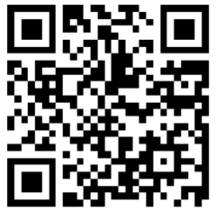
Thank You
Bruce Morton
APMP Fellow & President, 2 Oceans
bmorton10@aol.com
703-405-3103
Session Feedback:
Bruce Morton – 4 June 2024
25

