Slide 2
Stop Me If You’ve Heard This One Before
Rick Snee, RFP Team Manager, InvoiceCloud
Notes:
Hi, I’m Rick Snee, I’m a long time APMP member, first time presenter. I manage all RFx responses for InvoiceCloud, an online billing and payments company. I also write in my spare time, mostly short fiction and jokes. And what I’ve noticed in my 15+ years of writing proposals and comedy is that I generally flex the same muscles for both to make sure that I don’t sound like I’m delivering canned content.

Slide 3
Writing Comedy versus a Proposal
Comedy requires …
Knowing your audience
Discomfort
Originality
Rule of three
Callbacks
Notes:
When writing comedy, you generally want to write about discomfort. Every form of comedy, from observational humor about airline food to shock and gallows humor deals to some degree with pain or discomfort. Laughter is a coping mechanism, so comedy generally doesn’t work if the topic is anodyne.
There are always exceptions, of course. And some forms of comedy or topics are too extreme for some audiences. Which is why you must know your audience and get the sense of how far you can go with them.
Comedy requires originality. Musicians get to cover other musicians’ work. Artists and other writers get to adapt others’ work into new forms or build on them. But, being unoriginal in comedy cuts in two ways: comedians generally do not survive accusations of plagiarism, likely because funny stories require some degree of intimacy and that’s lost if they’re someone else’s stories. And two, punchlines lose their punch over time.
Comedy tends to follow the rule of three. There are variations on this. Like, if you’re putting together a list of examples, and one of them is the punchline, it should be the third of three. Like, “there are three inevitabilities in life: death, taxes, and singing the alphabet in your head when organizing your bookshelf.” Chris Rock, on the other hand, follows the rule of three so literally that he often repeats his punchlines three times.
Comedy requires a return to the beginning, a callback. So the audience can see all the connections you’ve made and understand. Otherwise, it looks like you just threw a bunch of concepts at them with no thought whatsoever.
And, wouldn’t you know it …

Slide 4
Writing Comedy vs. a Proposal
Comedy requires …
Knowing your audience
Discomfort
Originality
Rule of three
Callbacks
Proposals require …
Knowing your audience
Discomfort
Originality
Their own “rule of three”
Callbacks
Notes:
Will you look at that? I found the same concepts in proposal writing. In my proposal writing, anyway. And why? Because this is my presentation. But also because both comedy and proposals are about persuasion. I can’t persuade you either that the Happy Meal toy is just an apology for feeding your kids kangaroo meat or that you should buy my company’s product unless I:
Know my audience.
Cogently explain why you’re uncomfortable.
State it originally so that it doesn’t feel inauthentic or you’ve already heard it before – possibly with poor results.
Provide at least three examples to demonstrate that I know what I’m talking about. And then there’s the other proposal rule of three: tell them what you’re going to tell them, tell them, and then tell them what you told them; or …
A callback to the beginning.

Slide 5
How do we persuade?
Through connection.
Notes:
So, how do we persuade or, in other words, change a mind?
Well, comedians get to say a lot of things we normally wouldn’t. The really good ones make a connection, and the rest either go back to their day jobs or, if they really screw up, Get Cancelled. Getting Cancelled sounds terrible, until you remember that the original comedians—jesters and philosophers—usually ended up executed once they made a less-than-compelling proposal. I would rather Get Cancelled than be forced to drink hemlock, but I can’t speak for everyone.
Side note: Wouldn’t it be great to make SMEs wear these kinds of hats again?

Slide 6
Why do customers buy anything?
To look good?
To feel good?
To save time?
To save money?
Notes:
Most salespeople will tell you that customers buy something to do at least one of the following things:
Look good.
Feel good.
Save time.
Save money.
But, why? Why do they feel the need to save money? In what way? Why do they think they could look better to their own customers or peers? The answer to that question is:

Slide 7
Why do customers buy anything?
To look good?
To feel good?
To save time?
To save money?
PAIN
Notes:
PAIN.
For whatever reason, something is preventing that customer from saving time or saving money or looking or feeling good. Torture may not work when it comes to getting truthful information out of people, but self-perceived pain and the ability to remove a self-perceived barrier? That’s how we can change minds.
The same is true for comedy. I can’t think of many bits that don’t start from a painful place, whether it’s bad relationships, difficult parents, being in the wrong place in the wrong time, or having too many watermelons on your stage.

Slide 8
Working with Discomfort
Notes:
Both comedy and, in my opinion, proposals, require qualifying and quantifying discomfort.
We don’t typically work with discomfort. We learn to “deal” with it. But, if you’ve ever read Tom Sant (anybody here?), then you know that the verb “deal” is a weasel word unless you’re literally playing cards. It’s what we say when we don’t actually know what to do.
But, that’s where both good proposals and comedy live: in discomfort. Discomfort isn’t a barrier. It shouldn’t be a sign that you’re in the wrong line of work. Discomfort means that you’re about to show everyone why they pay you, a proposal professional, a moderate amount of money for an English or Communications degree.

Slide 9
What is the scariest moment in any proposal?
Notes:
Let’s take a moment to talk about a pain we all share in this room. What’s the scariest moment in any proposal?
Is it when the expiration date has dissolved off of the coffee creamer in the office fridge?
Before the printer starts, so you don’t know if you’ll be on the phone with IT all day?
When the Senior VP starts his first review the day before the proposal ships?
Or, is it when you’re looking at …

Slide 10
Notes:
… the blank page?
Look at it. If you’re one of those people who are uncomfortable with lulls in conversation, then the blank page is that lull in documentation. It’s just sitting there, making everything awkward because we don’t know the customer, or what they want, or how to do our job, and everyone hates us.
If there was ever a symbol for imposter syndrome, it would be a cursor just flashing in a white field.

Slide 11
What are we doing here?
We’re trying to persuade.
Notes:
At the very least, when planning a proposal response, we have to ask ourselves what we hope to achieve. And I recommend actually writing that down. I don’t have a lot of great conversations with lawyers. Well, the conversation’s fine, it’s the situation.
But, one of my favorite pieces of advice I ever received from a lawyer (besides “shut up”) was to write what I wanted the outcome of my litigation to be. That was her advice. Write down what you hope to achieve, and then we can talk about a plan.
As proposal professionals, we’re trying to achieve one of two outcomes:
The customer switches to us.
The customer stays with us.

Slide 12
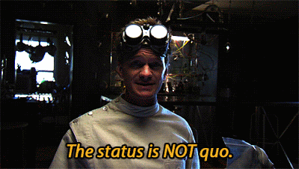
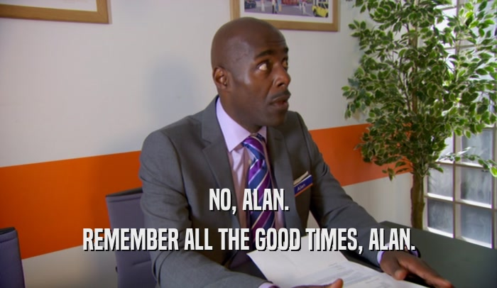
Let’s make that connection by sharing pain
Yo baby what’s up?
What are their organizational goals?
Why can’t they currently meet them?
What happens if they don’t meet them?
How can only you make them happen?
Baby please don’t go …
What goals have they met?
What progress do they lose by switching teams/products now?
How can only you keep them moving forward?
Notes:
You’ve got to know your audience and why they are in pain. Preferably, you should have that in their own words through capture or sales. Otherwise, you’re being presumptuous, even if you’re 100% right. You also want to have a sense of how raw or brutally honest you can get. We often hear that we don’t want to call someone’s baby ugly, but you can always compliment them by gushing about how much they remind you of Winston Churchill.
In a takeaway, you can rail all over the customer’s current situation. Within reason, obviously. You don’t want to sound like you’re holding their past over them. But, tactfully, through ghosting, you can explain why their current service provider will never save enough money or time or look or feel as good as they should. The why is the Pain.
In a recompete, well, that’s tricky. Given enough time, you could be perceived as part of that pain. Erroneously, of course. So, you have to quantify/qualify their pain in both takeaways and recompetes, but you also need to make clear that, when there is still work to be done, you’re right there with them with that solution you already discussed and ready to execute per plan.

Slide 13
What do we do with the blank page?
Notes:
So, going back to discomfort and the blank page, where do we begin with page one of our proposal?
Do we …

Slide 14
What do we do with the blank page?
Reuse?
Notes:
Look for a proposal from a similar project or customer? Okay. But where did that proposal come from? Another proposal. And that one came from another one before that, and so on. Given a robust enough proposal library from an old enough company, and you may be submitting content originally storyboarded by Howard Hughes.

Slide 15
What do we do with the blank page?
Reuse?
AI?
Notes:
Make a robot do it? I don’t want to get too into the weeds here about AI, because we’re still in early days of having access to this technology, and I plan to reuse this presentation for a number of years. So, I believe that the smart play is to stay neutral and be prepared to welcome my next cyberCEO without a Google problem.
I believe that AI can be used to answer roughly 70%+ of a proposal if that much of it is compliance-driven. But, for the compelling parts like your Executive Summary and approach sections, tread carefully. Start with at least a content plan before plugging in artificial responses, because starting with AI without a plan is basically reuse without carpal tunnel syndrome.
There, I said it. Moving on …

Slide 16
What do we do with the blank page?
Reuse?
AI?
Storyboard?
Notes:
I mean, yes, storyboarding is obviously the right answer, but that’s not what my presentation is about.
Show of hands: how many of you know that you’re supposed to storyboard? And how many of you actually get the time and buy-in from your teams to do it? And if your hand is still up, are you hiring?

Slide 17
Be original by being the author of your first draft
Notes:
The point is we need to be original. Or as I recently saw posed somewhere, why should I bother reading something that you couldn’t be bothered to write?
No matter how you start, whether you storyboard, create an annotated outline, update a dream journal, you will never be the author of your own work unless you write the first draft. Because, once the first draft is on the page, everyone else will just move the original pieces around. When a clock is ticking, we are inevitably bound to the tyranny of the first draft, because only a severe narcissist comes in at the last minute and forces everyone to start over with a new outline. If AI or someone who had an ashtray on their desk writes your first draft, you will never change it to the point that it becomes yours.
And if you want to bid with a potentially 20th century response to a customer with 21st century problems, or a bid that’s so generic that it can flood Facebook with movie trivia, then good luck.

Slide 18
Tips for original writing
Pain Point 1: You enjoy chili dogs, but you keep getting chili all over your face.
Pain Point 2: You’re too hard of a worker, and your competence makes others uncomfortable.
Pain Point 3: Too many bees.
Outline to pain points
Notes:
Hands up if you’ve worked from reuse and then found that your section’s too long. And so you’re just cutting out parts that don’t directly apply to your customer, because your reuse came from other proposals, right?
If you take anything away from my session, other than the Happy Meal apology thing, it’s that you should start from an outline and work your way in from higher levels.
So, since you know your customer, you should have 3 – 4 pain points ready to go. That is the starting point of your original, customer-focused narrative.

Slide 19
Tips for original writing
Pain Point 1: You enjoy chili dogs, but you keep getting chili all over your face.
Impact: Thoughtless people assume less of you when you have chili on your face, harming your chances of getting/staying employed or ever finding love.
Pain Point 2: You’re too hard of a worker, and your competence makes others uncomfortable.
Pain Point 3: Too many bees.
Outline to pain points
Write out the customer’s pain and impact
Notes:
Now, get into that pain point. Why is it painful? What’s it preventing your customer from achieving?
Now, this is where you get a little sneaky, because you’re reframing their admitted pain in a way that sets you up as their new best friend, hero, and if you don’t mind a meeting with HR, lover.

Slide 20
Tips for original writing
Pain Point 1: You enjoy chili dogs, but you keep getting chili all over your face.
Impact: Thoughtless people assume less of you when you have chili on your face, harming your chances of getting/staying employed or ever finding love.
Solution: You need a dog.
Pain Point 2: It hurts when you touch your stomach.
Impact:
Pain Point 3: It hurts when you touch your knee.
Outline to pain points
Write out the customer’s pain and impact
Directly solve those pain points
Notes:
So you’ve set it up, now knock it down with your solution.

Slide 21
Tips for original writing
Pain Point 1: You enjoy chili dogs, but you keep getting chili all over your face.
Impact: Thoughtless people (~95% of people in general) assume less of you when you have chili on your face, harming your chances of getting/staying employed or ever finding love.
Solution: You need a dog.
Letting a dog publicly clean your face will endear you to dog people, roughly 50% of the world’s population – a potential 45% improvement over current approval ratings.
Pain Point 2: You’re too hard of a worker, and your competence makes others uncomfortable.
Pain Point 3: Too many bees.
Outline to pain points
Write out the customer’s pain and impact
Directly solve those pain points
Retype, but don’t copy-paste, solution materials
Notes:
Now, maybe you have reuse from other proposals. After all, you’re in the face-cleaning dog business. How many ways can you really lick that problem?
But, I still recommend typing your reuse in because you’re more likely to get to the point faster. Hand typing means that you will take shortcuts that your reader will appreciate, as opposed to data dumping everything you know about dogs and the relative health benefits of their saliva and natural loofa-like surface to their tongue and ...
Keep your solution focused on the problem your customer has (shame), and then maybe expand on other benefits later on in your proposal.

Slide 22
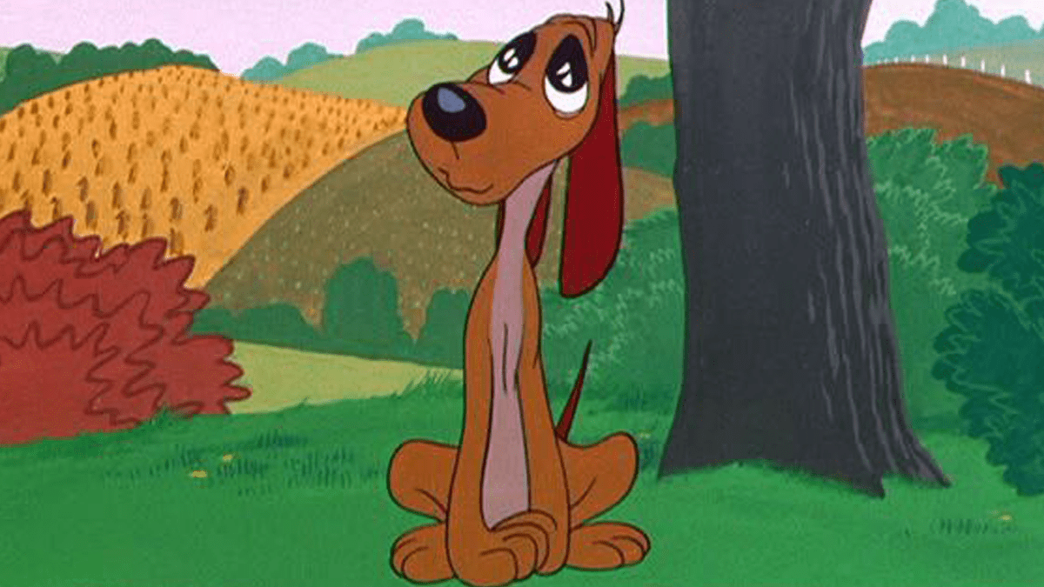
Tips for original writing
Improve public perception by 45%+ while enjoying chili dogs through our doggy kisses.
You enjoy chili dogs, but you keep getting chili all over your face. As a direct result, thoughtless people (~95% of people in general) assume less of you when you have chili on your face, harming your chances of getting/staying employed or ever finding love.
You need a dog. Letting a dog publicly clean your face will endear you to dog people, roughly 50% of the world’s population – a potential 45% improvement over current approval ratings.
Outline to pain points
Write out the customer’s pain and impact
Directly solve those pain points
Retype, but don’t copy-paste, solution materials
Summarize it in 30 words or fewer for your win theme
Notes:
And, wouldn’t you know it, now you have a win theme.

Slide 23
Rule of Three
Easy to remember
Notes:
So, you notice I recommended three win themes, no more than four. Why not two? Because, for some reason, two looks like you either forgot to say something or you don’t know enough about the customer. This is like the rule of three in science fiction, where when characters name examples, the cite two examples the audience knows and then one odd ball example that reminds you that you’re in the future. Like casually describing how governments banned leaded gasoline, smoking, and wifi brainjacking.
And then there’s references. Three references that prove that you have the best dog-licking, bee-stopping solution are better than two or one.

Slide 24
Rule of Three
You have too many bees in your life. Stop.
You don’t know where all these bees came from, but dear lord, there are too many.
BeeStop offers a three-point solution that means fewer bees, including moving away from garbage cans, smelling less like flowers, and an easy-to-use flamethrower.
1. Fewer bees through less garbage.
Bees like garbage. Move.
2. Less bee contact through fragrance-free body products/detergents.
Bees like flowers. Don’t smell like one.
3. Don’t BEE mad, BEE even.
Easy to remember
Repetition
Notes:
There’s also the proposal rule of three mentioned earlier. Well, at the beginning, I told you what I was going to tell you, now I’m wrapping up telling you, and then I’ll close out with telling you what I told you. In your executive summary, you can accomplish a similar effect with your value proposition and summary of your overall response, followed by your three win themes, and then a features and benefits table.

Slide 25
Rule of Three
Easy to remember
Repetition
More impactful
Notes:
You don’t want to waste people’s time by saying things that only matter once. A key test to your content is whether you can say it three times because it’s that important. And then do that—say it three times.
As I mentioned before, Chris Rock often repeats punchlines three times. Even in a row. The reason why he can do that, and why it works, is because he’s connected with the audience and presented a premise where not only is the punchline the only logical conclusion, but it only gets more impactful with each repetition. And it works, because anyone who quotes Chris Rock usually repeats a line he said three times.
In fact, Chris only incorporates a premise into his standup if he’s talked about it off stage three times. That means it’s time to cover it on stage. Or maybe he only remembers to write about it because he talked about it three times. Who knows?
The point is: three. Not two, not four, and five is right out.

Slide 26
Callbacks
Remind the reader
Connect to previous points
Close out where you started
Notes:
So, you’ve probably noticed that I’ve called back to ideas presented earlier. This accomplishes three things:
It reminds you of those earlier things I want you to remember.
It connects this new idea I’m presenting to earlier points (which I’ve likely repeated three times), so you know I’m building to something and not wasting your time.
It allows me to close roughly where I started without a shoehorned-on summary. I’m telling you what I told you, but without an “in conclusion” statement. And when I repeat my starting point, that writing like a comedian can help you submit fresh, impactful content with a higher chance of persuading and winning.

Slide 27
Questions?
(You may now heckle the proposal writer.)

Slide 28
Or heckle me online
I crave your attention. Please review my session.

