Slide 2
Thriving on Thin: A Practical Guide to Lean Proposal Management
Melissa Shoemaker, CF APMP – VP of Proposal Operations, Compass Government Solutions
Kel Raleigh – BD & Proposal Manager, K2 Consulting, Inc.

Slide 3
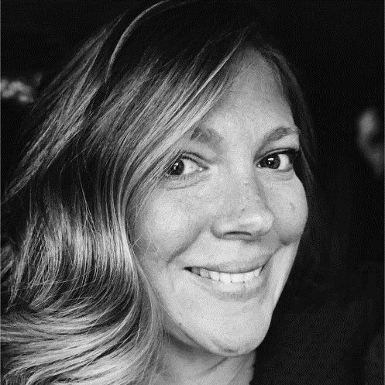
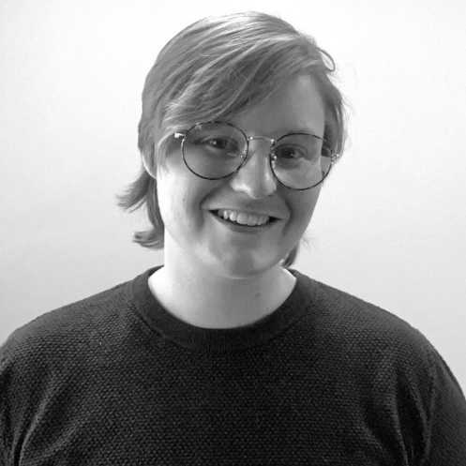
Who We Are
Mel Shoemaker, CF APMP Compass Government Solutions
10+ years’ experience
CF APMP & Shipley Training Certified
BS - Criminal Justice & Psychology, University of Maryland
Hobbies: Real Estate Investing, Newborn Screening Advocacy, Boating, Book Club
Kel Raleigh, MFA K2 Consulting, Inc.
5+ years’ experience
CF APMP & Shipley Training Certified
MFA – Writing & Publication Design, University of Baltimore | BA – English, Mansfield University of Pennsylvania
Hobbies: Baseball & Softball, Crochet, Creative Writing, Reading, Swimming

Slide 4
Challenges of Lean Proposal Departments
Working Solo / Limited Resources
Resource Allocation
Time Constraints
Expertise & Skill Gaps
Competitive Disadvantages
Adapting to Changes
What We’ll Cover:
Strategic Efficiency
Adaptability in Action
Mentorship Momentum
Community, Collaboration, and Resilience

Slide 5
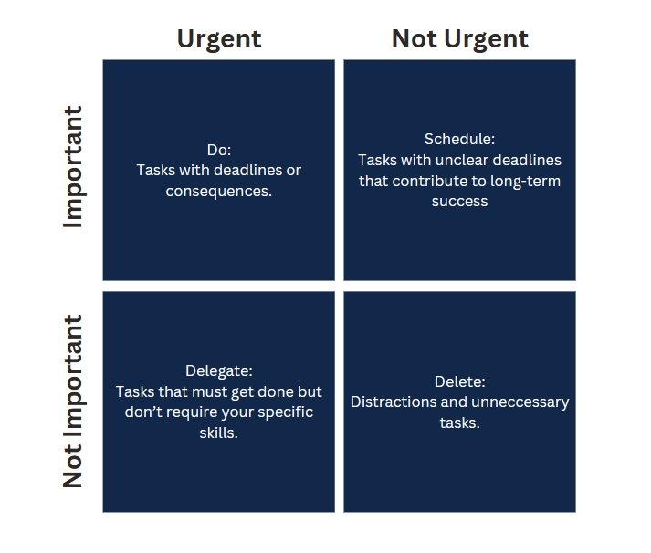
Strategic Efficiency In Action: Practical Time Management
Accurate Set-Up from Day 1
Prioritize Tasks
Set Clear Deadlines
Utilize Project Management Tools
Break Down Projects
Block Time
Delegate Responsibilities
Use Templates and Standardized Processes
Implement Agile Methodologies
Check-In Regularly

Slide 6
Strategic Efficiency In Action: Tailoring Development Strategies for Your Team
Simplify & Streamline
Research Your Customer
Allocate Resources
Provide Training & Development
Utilize Automation & Technology
Manage Your Risks
Encourage Continuous Improvement
Collaborate Cross-Functionally
Focus on Value Propositions
Implement Quality Assurance

Slide 7
Adaptability in Action: Personal Skill Alignment & Collective Success
Communication Skills
Problem-Solving
Attention to Detail
Creative Thinking
Organizational Skills
Leadership Abilities
Adaptability and Resilience
What personal skills do you bring to the table that aren’t typically listed on a “Proposal Manager” Job Listing?
What have you learned in other jobs that you apply to proposal management?

Slide 8
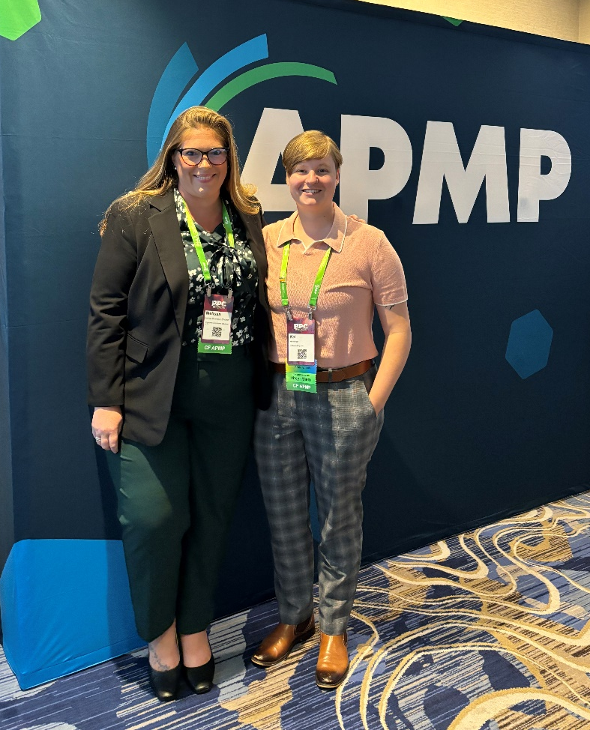
Mentorship Momentum: The Impact of Mentorship in Small Businesses
Guidance & Expertise
Networking & Opportunities
Personal & Professional Development

Slide 9
Mentorship Momentum: Identify & Cultivate

Slide 10
Community, Collaboration, & Resilience: Collaboration Strategies
Cross-Functional Teams
Collaborative Tools & Platforms
Regular Team Meetings
Feedback & Review Process
Knowledge Sharing Sessions
Client Collaboration
Flexibility & Adaptability
Celebrate Achievements
Post-Proposal Evaluation
Within a company, collaboration strategies are critical to proposal management. Sometimes collaborating with other proposal managers outside of the company without sharing proprietary information can also help.

Slide 11
Community, Collaboration, & Resilience: Turning No’s into Learning
Deconstruct the Feedback
Identify Lessons Learned
Seek Candid Feedback
Benchmark Against Competitors
Implement Corrective Actions
Embrace a growth mindset

Slide 12
Resources Overview
Consultants (Compliance)
APMP Body of Knowledge
PTAC (APEX Accelerators)
Podcasts & YouTube Webinars
Capture2Proposal, WinCenter, SalesForce
Mentors

Slide 13
Take Away Thoughts
Embrace Efficiency
Harness Collaboration
Invest in Mentorship
Turn Setbacks into Opportunities
Celebrate Achievements

Slide 14
Keep in touch!
Mel Shoemaker, CF APMP Compass Government Solutions
Melissa.shoemaker@compassgovernmentsolutions.com
In/melissashoemaker
Kel Raleigh, MFA K2 Consulting, Inc.
kraleigh@k2consulting.com
In/kraleighwrites

