Slide 2
High Functional Hybrid: Developing Winning Proposals with a Remote Workforce
By: Lauren Kahn, Director of Business Development & Samantha Fitzsimmons, Project Manager for Proposals
Telecare Corporation, California
June 5, 2024

Slide 3
About Us

Slide 4
Hybrid Defined
Hybrid
Permanent remote
Some team members in office
Various time zones
Some days on site
Some people in same cloud-based network, some not
Variable access to equipment and technology
Mixed access to engagement activities

Slide 5
Agenda
Setting the rules of engagement
Build the team’s endurance
Leverage technology
Weave in failure prevention
Staying in the Game (Without Being on the Field)
Questions & Open Discussion

Slide 6
Set the Rules of Engagement

Slide 7
Set, publicize, and adhere to the rules of engagement
Project transparency – make it easy for people to drop into projects:
Timelines are published – be fanatical about deadlines (and keep your secret backup deadlines a secret)
Set the time zone or core hours for meeting availability
Set the standard to be on camera most of the time
No explanation required when not on camera
Every meeting has an agenda and a leader
Consider standing agendas
Clarify when there is open discussion versus decision-making

Slide 8
Set, publicize, and adhere to the rules of engagement
Keep your processes the same no matter how different the projects seem
Follow your steps
Keep the nomenclature across projects
Use templates (full summary, pre-submittal checklist, etc.)

Slide 9
Build Team Member Endurance

Slide 10
Build Endurance of Team Members
Make the most of meetings
Schedule 25 and 50 minute meetings – 1 hour should never be the default
Start and end meetings right on time - end early whenever possible
Does the meeting need to occur? Don’t be afraid to cancel meetings up to the last minute
Do you have a reason to go?
Define what it means to come to a meeting prepared
*Forbes: Our Brains Need Breaks From Virtual Meetings, by Bruce Rogers, April 20, 2021.

Slide 11
Build Endurance of Team Members
Look for ways to foster teamwork and celebrate success
“Ice Chips” in the chat at the beginning of meetings (replace the “water cooler” conversations)
Low stakes questions that require just a few words to answer as everyone is joining the call
Coffee or tea in the morning?
Favorite way to decompress after work?
Dream vacation spot?
Celebrate wins and successfully completing projects
Post submission gratitude sessions – can take ten minutes – can be an email
Conduct a root cause analysis or post mortem when things don’t go well and when they do go well
*Forbes: Five Reasons Why Celebration and Gratitude Can Reduce Your Stress, by Luciana Paulise, October 31, 2023

Slide 12
Leveraging Technology

Slide 13
Leverage Technology Only When It’s Truly Useful
Use of AI
Shared virtual workspaces
Dropbox, Box, Google Drive, Proposal Management Software, etc.
Clarify communication channels for editing and approving elements
Shared documents in the cloud/track changes/chain of custody
Service level agreements
Smartsheet timelines
Rely on your systems as you create them – improve, don’t duplicate

Slide 14
Weaving in Failure Prevention

Slide 15
Weave Failure Prevention into Every Process from the Very Start
Everyone is accountable for the proposal due date
Generate SME buy-in for needed contributions, even if they’re “volun-told”
Avoid Optimism Bias
Tendency to underestimate the likelihood of negative events, and to expect that things will turn out well, even if rationality suggests otherwise
90-90 Rule
The first 90 percent of a project accounts for the first 90 percent of the development time. The remaining 10 percent accounts for another 90 percent of the development time. –Tom Cargill, Bell Labs

Slide 16
Staying in the Game

Slide 17
Being in the Game Without Being on the Field*
What managers do in a remote environment is the same. How they do it changes.
Be present and hands on without being intrusive
Don’t: micromanage (restrict by undermining and disempowering)
Do: micro-understand (trust and delegate, integrate into the workflow, iron out the wrinkles, look for warning signs, problem solve)
Building connection takes a little more effort – but it’s worth it
*Harvard Business Review: What Great Remote Managers Do Differently by Raghu Krishnamoorthy October 26, 2022

Slide 18
Three Takeaways
Tired staff make mistakes
RFPs are complicated enough – keep your process, clear, simple, and predictable
You only have to build structure once – it’s worth the investment

Slide 19
Thank you!
Contact Us:
Lauren Kahn, Director of Business Development, LKahn@telecarecorp.com
Samantha Fitzsimmons, Project Manager – Proposals, Sfitzsimmons@telecarecorp.com

Slide 20
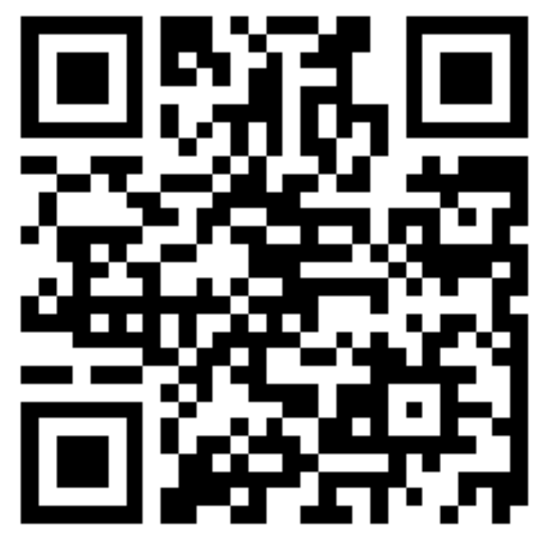
Questions?
Reminder & Request:
Please complete the Session Survey using this QR code.
For Questions:
Please use the mic for any questions.
What “best practices” have worked
for your hybrid teams?
What is the future of hybrid teams at your workplace?

