Slide 1


Slide 2



PREPARING YOUR
Content
AI
FOR THE
Revolution
Kelson Forsgren
VP
Shipley Associates
Lisa Puckrin
Consultant
Shipley Associates
Notes:
Kelson:
Hello, and welcome to Preparing Your Content for the AI Revolution. I am Kelson Forsgren from Shipley Associates and I am here with my friend and colleague Lisa Puckrin. We are pleased to be here to learn from each other and share our experiences with you.
We approach content management from two components of the same equation: Lisa’s background in content and response management is mostly using Q&A pairs, and my background is mostly in narrative responses. We will share ideas using both lenses in our presentation today.
Lisa’s joke!

Slide 3


Proposal Content
Management Evolution
    AI
    Acceleration Era
    2023-
    Biggest shift since advent of the Internet!
Generative AI
    Response Management Era 2012-2023
    Content Management Platform Era
    2005-2012
    Information stored in Q&A pairs
    Architecture, tagging, keywords became crucial for AI/auto respond
    Automation feature race
    Microsoft Online Era
    2000-2010
    SharePoint:
    Content stored in documents
    Excel: Quick facts
    No automation
    Sant software
    Started to explore use of Q&A pairs
    Build proposal
Notes:
Lisa: Microsoft Online Era
Kelson: Content Management Platform Era. The online era overlapped with what became the Content Management Platform era. We are defining this as Proposal Content Management and not including the larger content management systems used for marketing, websites, and internal business documents.
In 2006, Sant Corporation began offering their proposal software as a service.
Lisa: Response Management Era
Kelson: Automation Era

Slide 4
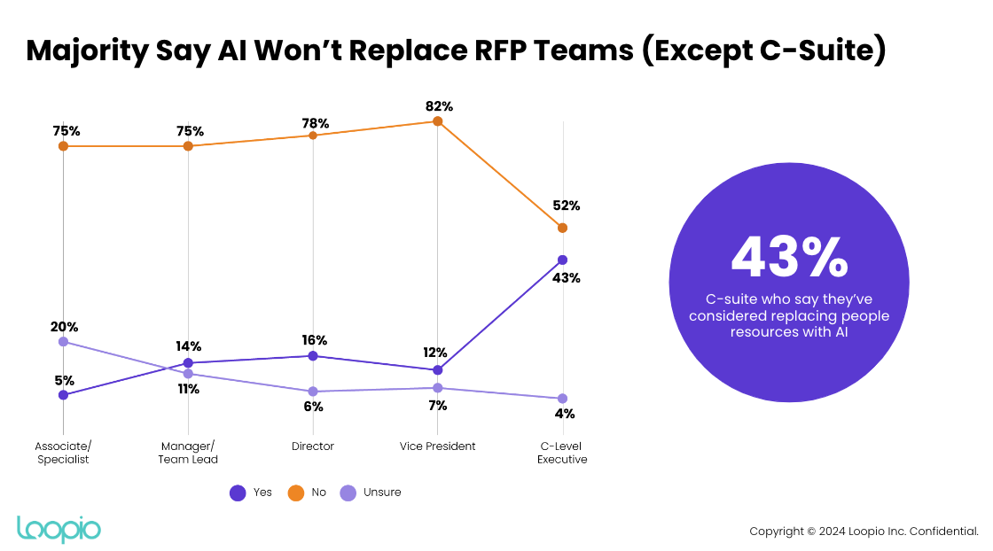
Survey Question:
Do More with Less
Notes:
Lisa

Slide 5
“
KPMG survey found that 61% of US CEOs are encouraging employees
to use generative AI to automate mundane tasks.”
CNN
“4-day workweeks may be around the corner”
April 2024
Notes:
Kelson:
How many of you in the room have been asked to use generative AI in your current work?
How many of you are NOT allowed to use generative AI in your current work?
We believe that the trend towards more adoption of generative AI will continue.

Slide 6
Where
should
start
you
?
Notes:
Kelson
So with all the hype, where should you start? Since we are talking about content management, where can you start?

Slide 7

Generative AI?
Notes:
Kelson:
Maybe 18 months ago, the prevailing thought at the Executive level regarding Generative AI replacing people was like this button: “Easy!”
Since that time, however, executives are taking a more cautious approach. Their current sentiments align more closely with what Sam Altman (of OpenAI) said at the Microsoft Build conference two weeks ago:
"[Generative AI] doesn't get you out of the hard work of building a great product or a great company or a great service. You still have to do it.
AI alone is a new enabler, but it does not automatically break the rules of business.
And so you can use this as a new thing to do, but you still have to figure out how you're going to build enduring value in whatever you're doing."

Slide 8
GenAI:
Replacement or Tool?
GenAI is a tool
Options are still the “Wild West”
Mixed viability to search real-time data
Project management missing
Variety of adoption
Best current solution?
Response management
platforms + GenAI
Set parameters
Validation is essential
Notes:
Kelson
In that spirit, Generative AI is a tool to add to our toolkit, not a solution to replace our toolkit. Why?
It’s still the “Wild West”: Vendors are entering the market or adding AI to existing solutions. Messaging is heard, read, and seen throughout the Proposal Management industry and across all business activity. No consolidation yet.
Mixed viability to search real-time data. If using GenAI outside of your own repository, will it return with real-time data?
Project management missing. It will take some time for GenAI to integrate within a project management setting
Adoption: And a part is on us—how do we adopt it?
Best current solution? Combine response management platforms with GenAI. Still validate any content generated and set parameters for its use.

Slide 9
Response Management Platforms
Optimizing Auto Respond’s performance
  Matrixed content architecture
  Simple questions
  Clean and concise answers
Search Tools
GenAI Capabilities
Notes:
Lisa: Mini-TOC for next several slides

Slide 10
Matrixed Content Architecture
Business Unit 1
Business Unit 2
Business Unit 3
Business Unit 4
Corporate
Company Overview and History
HR
Legal
Insurance
Security
Physical security
Virtual security
Certifications
Notes:
Lisa: examples more real; product lines

Slide 11
Simple Questions
How the client wrote it isn’t always how you should store it
Challenge
Example
Solution
Describe your implementation approach. How long will it take? What resources will you assign? What extra costs might be incurred?
Multiple questions in one RFP question
Break apart to store
How will you put our solution in place?
Awkward phrasing
Rewrite
What is the optimal implementation strategy for our unique, hard-to-configure, customized solution which requires your A-team to implement?
Too wordy
Simplify
Notes:
Lisa

Slide 12
Quality Answers
Clear
Concise
Correct
Notes:
Our content needs to include quality answers, whether for Q&A pairs or for narrative sections. Quality can be measured in many ways, but most consistently must be clear, concise, and correct. These “C’s” are critical to customer-centric content that connects solution with value.
For example, “concise” here means to keep the content directly responsive to questions and topics. Keep the content focused on benefits the customer gains from your solution. Elaboration, if any, should come in the proposal itself.
By ensuring quality content is stored in your repository, you are best prepared for AI assistance. Where with traditional response systems you prepare content for a human audience to understand and draw from, with AI, you are preparing your content for a machine to understand and leverage.

Slide 13


Words:
Friends or Enemies?
  Words as
  your friends:
  Common words
  Industry terms
  Reusable (not client-specific)
  Benefit specific
Words as
your enemies:
Jargon
Unusual/
strange phrasing
Gobbledygook
Notes:
We’ll look here at a few examples of how words in your repository, queries, and prompts for GenAI can be your friends or your enemies. We are using Louis from “Princess and the Frog” to represent good/friendly word choices and Dr. Facilier to represent poor/enemy word choices.

Slide 14
Automation Efficiency
Auto respond from established library
50%+
Find the answer in established library using search tools
30%
Generative AI + validation
10%
Write new content
10%
Notes:
Lisa

Slide 15



Auto Respond Expectations
70-90%
50-70%
40-50%
Corporate
Security
Technical/product
Notes:
Lisa

Slide 16
Search Tools to Find Tough Content
Keyword (overtype)
Boolean search operators
(AND, OR, NOT)
Phrase “SOC 2 Report”
Proximity “security certification”~5
Fuzzy (~ at end of a single-word term)
Wild Card (* at start or end of word;
? anywhere in the word)
Stemming
Notes:
Lisa

Slide 17
How can GenAI help?
Combine answers
Change tone
Change length
Translate to different languages
Develop alternate answers
Create first draft Executive Summaries or section contents
Notes:
Combining answers: GenAI can help us scrub content within the repository and combine multiple answers to possibly create a new answer that is cleaner and better than before. It can help us fill gaps in our responses (that we must still validate and review).
Change tone: more professional, more personal
Change length: shorter or expanded
Translate:
Alternate answers: One of my favorite uses, GenAI can help identify options or alternatives to our current solution that may be of value to the customer. We can consider these answers strategically, which may help us shape other answers in the repository.
First draft: Another of my favorite uses is to ask GenAI to create a draft Executive Summary or draft section based on the hot buttons, pain points, or requirements I provide it. It still needs to be reviewed and validated, but Generative AI has surprised me sometimes with the clarity it has provided as a starting point.

Slide 18
Generative AI Prompts
Initial Prompt Formula
Prompt Follow-Up Formula
My role and activity
Affirmation
+
Clarification
+
My need froom AI
of need or continuation
+
+
My objective
+
More context
+
More
What AI should consider
+
What response I expect and how
instruction
Notes:
Here we’ve included some prompt strategies for Generative AI. You will notice that these prompt suggestions aren’t short. Counter to our web searching or other means of word searching, a short or ambiguous prompt decreases the probability of the output quality you want.
The initial prompt shows what we recommend for content to help GenAI work best. It accounts for all the logical pieces of information AI needs to generate higher quality information or insights that you seek.
Follow-on prompts allow us to build on the information we have already received, reshape it to better focus on certain points we want to explore further, or even have GenAI validate its output. These prompts help reduce the probability of imprecise or inaccurate output, and can help GenAI help us shape better proposal content.

Slide 19
Active Content Management Is Crucial
Benefits of dedicated content manager
Focus
Consistency
Platform optimization
Quality/brand standards
Current/accurate (SME partnerships)
Content library expert
1
Notes:
Lisa

Slide 20
Content Management Best Practices
2
Use moderation
Clean it up and make resusable before it goes into the library
Set review cycles
and stick to them
  Corporate: Annually
  Security: Annually
  Technical/Product: Quarterly or product release cycle
Dedupe
  Searching
  Dedupe tools
Make it easy to
add new content
  Monitor proposal manager contributions
  Err on the side of too many Q&A pairs rather than too little
Monitor content usage
  Monitor content usage (crowdsourcing approval)
  Purge annually based on usage
Notes:
Lisa

Slide 21
Where do we think the industry is headed?
Keep calm and carry on –this isn’t the end of the proposal world
World between marketing, product, and proposals converges
Eliminate content housing duplication (Internet/Intranet/Response Management Platform)
Our jobs are moving from tactical to more strategic
Response platform space to consolidate (crowded market; lots of new GenAI entrants)
Continue shift and innovation (stay informed, be curious and flexible)
Notes:
Both: Lisa first three; Kelson last three

Slide 22

Questions?
Please come to the microphone…

Slide 23

Connect with us:
Kelson Forsgren
kforsgren@shipleywins.com
Lisa Puckrin
lpuckrin@shipleywins.com
Complete the BPC survey in the Zoom Events app to share your feedback!
Notes:
Kelson

